Slide 1
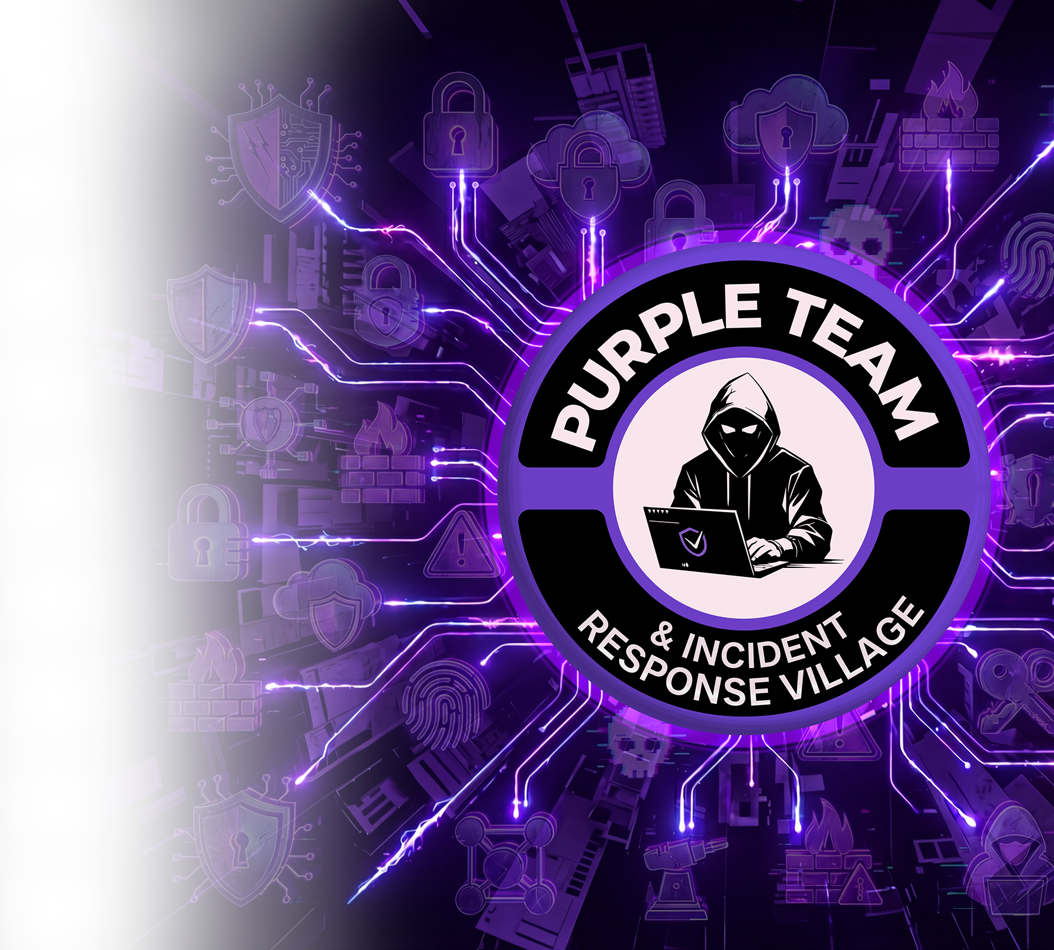
INCIDENT RESPONSE,
REWRITTEN BY AI
How AI reconstructs the full attack path of a cloud or server breach
— from initial entry to lateral movement
— and turns containment from days into minutes.
30-MIN BRIEFING
LIVE: GITHUB TOOL RELEASE
Camilo Fernández · Founder & CEO, Devel Group

Slide 2



BEFORE WE START
It's 2 AM. Your phone rings.
A quick question for the room — be honest.
How many of you have ever been an incident responder — or had to answer that call?
2:00 AM
A 50-person bridge
And the real question
You wake up to a call you hoped would never come. "We think we've been breached."
You dial in. Executives, legal, vendors, the SOC — all of them waiting. All of them looking at you.
Where did they get in? What did they touch? Are they still inside? Right now — you don't know.
That gap between the call and the answer — that's what this talk is about.
DEVEL GROUP · RED SPEARS LABS
02

Slide 3



THE NUMBER THAT SHOULD WORRY YOU
How long until you actually know what happened?
From the moment a breach starts to the moment you have the full picture — entry point, every action, current exposure.
TRADITIONAL · MANUAL IR
WITH AI · AGENT-DRIVEN IR
Detect the breach is even happening
~204 days
Detect — AI watches telemetry continuously
Minutes
Scope it — pull and correlate the logs
2–4 weeks
Scope — agents ingest all sources at once
Seconds
Reconstruct the full attack path by hand
60–80 hours
Reconstruct the attack path automatically
Minutes
Decide and execute containment
Days more
Containment staged, ready for approval
Same hour
TOTAL: weeks to months before the picture is complete
TOTAL: the full picture within hours of the first signal
That's the shift: weeks of manual forensics compressed into a single working session.
DEVEL GROUP · RED SPEARS LABS
03

Slide 4




30 MINUTES · WHAT WE'LL COVER
The roadmap
01
The global shift
6 min
Why incident response is being rebuilt around AI
02
Walking a breach
10 min
One cloud intrusion, reconstructed step by step
03
Tools & how-to
8 min
Which AI tools to use, and how to wire them in
04
The GitHub release
6 min
Open-sourcing our AI analytics toolkit — live
DEVEL GROUP · RED SPEARS LABS
04

Slide 5
WHY THIS MATTERS
The clock has always been the enemy
Traditional incident response is a manual race against an automated adversary. By the time analysts piece the story together, the attacker is long gone.
204
73
80%
DAYS
HOURS
OF TIME
median time to identify a breach before containment even begins
of analyst effort to manually reconstruct one cloud intrusion
spent collecting & correlating logs — not actually responding
The asymmetry: attackers automate. Defenders still investigate by hand.
DEVEL GROUP · RED SPEARS LABS
05

Slide 6
THE GLOBAL SHIFT
From forensics to foresight
YESTERDAY · MANUAL IR
TODAY · AI-DRIVEN IR
—
Analysts hand-pull logs from every console and SIEM
Agents ingest cloud, identity & endpoint telemetry in seconds
—
Timeline assembled in spreadsheets, days after the fact
Attack path reconstructed automatically as a causal graph
—
Root cause is a hypothesis, rarely a proven path
Root cause is a proven chain of evidence, not a guess
—
Containment waits for human consensus
Containment actions proposed — and pre-staged — instantly
—
Knowledge dies in a PDF nobody re-reads
Every incident becomes reusable, queryable knowledge
DEVEL GROUP · RED SPEARS LABS
06

Slide 7



THE CAPABILITY
Four things AI does that humans can't do fast enough
Correlate at scale
Reconstruct the path
Explain the intent
Pre-stage the response
Reads millions of log lines across cloud, identity and endpoint sources — surfaces the 12 that matter.
Links events into a causal attack graph: entry → escalation → lateral move → objective.
Turns raw IOCs into a human narrative — what the attacker wanted, and why.
Generates the exact containment actions and the commands to execute them.
DEVEL GROUP · RED SPEARS LABS
07

Slide 8
PART 01
A breach in the cloud — walked end to end
We follow one real intrusion pattern: a leaked key in a public bucket. AI reconstructs every step the attacker took — and shows us exactly how to slam the door.
DEVEL GROUP · RED SPEARS LABS
08

Slide 9






THE RECONSTRUCTED ATTACK PATH
From one leaked key to full data exfiltration
AI builds this graph automatically from telemetry — each node is a proven event, each arrow a causal link.
STEP 1
STEP 2
STEP 3
STEP 4
STEP 5
STEP 6
INITIAL ACCESS
CREDENTIAL USE
PRIVILEGE ESC.
LATERAL MOVE
COLLECTION
EXFILTRATION
Leaked IAM key found in a public repo
Key authenticates from a brand-new ASN
Over-permissive role grants admin scope
Pivots into compute & database subnets
Snapshots a production DB volume
Snapshot shared to an external account
Every node is auto-mapped to MITRE ATT&CK
T1552 · T1078 · T1098 · T1021 · T1530 · TA0010 — the path doubles as a defensible, framework-aligned report.
DEVEL GROUP · RED SPEARS LABS
09

Slide 10


FROM OUR OWN DESK · A REAL INCIDENT CASE
A real AWS breach — 2 days of work, done in 2 hours
We were called in on a real incident case: a confirmed compromise inside an AWS environment. Here is what changed when our agents ran the full investigation.
THE SITUATION
Confirmed compromise in AWS — suspicious IAM activity and an unexplained data transfer. The job: detect the scope, prove the full attack path, and deliver a containment plan.
THE OLD WAY — MANUAL
WITH OUR AGENTS + SYSTEM PROMPT
16 hrs min — up to 2 days
2 hrs full cycle
Detection, scoping, attack-path reconstruction and the containment plan — all done by hand, analysts correlating CloudTrail, flow logs and IAM history.
Detection, full attack-path reconstruction and a staged containment plan — the entire cycle, agents ingesting every source at once.
~8x faster
Full path
Same day
detection to containment
entry to exfiltration, evidenced
containment plan delivered
DEVEL GROUP · RED SPEARS LABS
10

Slide 11


POINT A · THE TRIGGER
The agent starts where the alert lands
An IR agent never starts from a blank page. It starts from a single signal — one alert, one anomaly — and validates outward from there.
The validate-and-expand loop
THE STARTING SIGNAL
OBSERVE
"GuardDuty: anomalous S3 API call from unrecognized IP — UnauthorizedAccess:IAMUser/InstanceCredentialExfiltration"
Pull the raw event behind the alert
VALIDATE
Confirm it with a second, independent source
This is Point A. Everything else is unknown.
EXPAND
?
Whose key is it?
Follow every entity the event touches
?
Is it still active?
?
What did it touch?
REPEAT
Each new entity becomes the next Point A
?
Where did it go next?
DEVEL GROUP · RED SPEARS LABS
11

Slide 12
HOW THE AGENT VALIDATES
Each step is proven before the next begins
A
Anomalous S3 call flagged
CloudTrail event confirms the API call & source IP
AbuseIPDB + Shodan score the IP as malicious infra
B
Identity behind the key
IAM access-key ID resolves to an EC2 instance role
CloudTrail shows the key was never used from this ASN before
C
How access escalated
Role policy review reveals wildcard admin permissions
Config timeline shows the policy change predates the breach
D
Where it moved
VPC flow logs show new east-west traffic to the DB subnet
EDR (Cortex XDR) confirms no process on the host did this — it's API-only
E
What left the org
CloudTrail ModifySnapshotAttribute shares a volume externally
The destination account ID is outside the org — exfiltration confirmed
No step is trusted on a single source — two independent confirmations, or it stays a hypothesis.
DEVEL GROUP · RED SPEARS LABS
12

Slide 13



CLOSING THE DOOR
From proven path to staged containment
Once the path is proven, AI maps each attacker foothold to a precise containment action — ranked by blast radius, ready for a human to approve.
Revoke the credential
Disable the IAM key & attach an explicit deny policy
CONTAIN
Block the infrastructure
Quarantine the source IP / ASN at WAF & security groups
CONTAIN
Cut the escalation path
Strip the wildcard policy; re-scope the role to least privilege
ERADICATE
Stop the exfiltration
Revoke the external snapshot share; rotate DB credentials
ERADICATE
Harden & verify
Enable bucket public-access block; confirm no persistence remains
RECOVER
DEVEL GROUP · RED SPEARS LABS
Human-in-the-loop: AI stages the commands. A responder approves. Nothing destructive runs unattended.
13

Slide 14

THE KNOWLEDGE PATH
One incident, four artifacts — generated automatically
The attack graph
The executive narrative
The ATT&CK map
The response runbook
A visual causal chain — every node evidenced, every edge a log reference.
Plain-language story of what happened, in business terms, for leadership.
Techniques tagged end to end — feeds detection engineering & purple teams.
Ranked containment actions with exact commands — reusable next time.
The PDF nobody re-read is now a queryable knowledge base. Next breach, the agent starts already knowing this one.
DEVEL GROUP · RED SPEARS LABS
14

Slide 15
PART 02
Which tools to use — and how to wire them
The AI is only as good as what it can see and touch. Here is the practical stack: enrichment, telemetry, reasoning, and action.
DEVEL GROUP · RED SPEARS LABS
15

Slide 16


THE IR TOOL STACK
Four layers an AI responder needs
TELEMETRY
CloudTrail · VPC Flow Logs · GuardDuty · Cortex XDR · SIEM
What happened — the ground truth
ENRICHMENT
VirusTotal · Shodan · AbuseIPDB · MalwareBazaar · YARA
Is this entity known-bad?
REASONING
LLM agent · attack-graph builder · MITRE ATT&CK mapper
Correlate, hypothesize, narrate
ACTION
Cloud API calls · WAF / security groups · IAM policy engine
Contain, eradicate, recover
DEVEL GROUP · RED SPEARS LABS
16

Slide 17
HOW TO DO IT
The reference architecture
Tools become agent capabilities through one contract — a tool-use / MCP layer. The LLM orchestrates; the tools execute.
1
INPUTS
Telemetry & enrichment APIs feed normalized signals
CloudTrail
GuardDuty
VirusTotal
Shodan
AbuseIPDB
2
ORCHESTRATION
LLM agent reasons over an MCP / tool-use contract
Plan
Call tool
Validate
Expand
Decide
3
OUTPUTS
Graph, narrative & staged containment commands
Attack graph
ATT&CK map
Runbook
Approval gate
DEVEL GROUP · RED SPEARS LABS
17

Slide 18

THE AGENT'S OPERATING CONTRACT
It all starts with the system prompt
The prompt tells the agent to begin at Point A and validate forward — never assume, always confirm. A full template ships with the repo.
ir-agent.system.md
Why this design holds
# ROLE
Bounded start
You are an incident-response analyst agent.
No blank page — one signal anchors the whole investigation.
# PRIME DIRECTIVE
Start from the single triggering signal (Point A).
Forced validation
Validate every claim with TWO independent sources
before treating it as fact. Never assume intent.
Two-source rule kills false positives and analyst bias.
# LOOP
Self-extending
observe -> enrich -> validate -> expand -> repeat
Each confirmed entity becomes the next Point A.
Each proven entity reseeds the loop until the path is whole.
# CONSTRAINTS
Safe by default
- No destructive action without human approval.
- Cite the log/source for every node you assert.
Containment is staged, never auto-fired — human approves.
- Map each step to MITRE ATT&CK.
DEVEL GROUP · RED SPEARS LABS
19

Slide 19
PART 03 · LIVE RELEASE
We're open-sourcing the toolkit
Everything you've seen — the enrichment agents, the attack-graph builder, the system prompt — released free for the security community.
DEVEL GROUP · RED SPEARS LABS
20

Slide 20
GET STARTED IN MINUTES
Three commands to your first reconstruction
terminal
What you get back
$ git clone github.com/devel-group/ai-incident-response
An interactive attack-graph report
cloning toolkit + sample telemetry... done
A MITRE ATT&CK coverage map
$ docker compose up -d enrichment-agents
virustotal · shodan · abuseipdb · yara ready
A ranked containment runbook
$ ir-agent investigate --signal alerts/point-a.json
validating... expanding... mapping ATT&CK...
An executive-ready incident narrative
attack path reconstructed -> report.html
Apache-2.0 licensed · contributions welcome · built for LATAM banking & fintech
DEVEL GROUP · RED SPEARS LABS
22

Slide 21
FOR YOUR TEAM
How to adopt this without boiling the ocean
01
02
03
ASSIST
ACCELERATE
ORCHESTRATE
Run AI alongside analysts. It drafts the timeline; humans verify everything.
AI owns enrichment & graph-building. Analysts focus on decisions & containment.
AI runs the full loop and pre-stages containment. Humans approve at the gate.
Weeks 1–4
Months 2–3
Month 4+
The rule that doesn't change: AI compresses the investigation. Humans still own the irreversible decisions.
DEVEL GROUP · RED SPEARS LABS
23

Slide 22
WHAT TO REMEMBER
Five things to take back to your SOC
Incident response is shifting from manual forensics to AI-driven foresight — globally, now.
1
AI's edge is reconstruction: it builds the full, proven attack path from entry to exfiltration.
2
The agent starts at Point A — one signal — and validates outward with two independent sources.
3
Pick tools by the question: enrichment, telemetry, reasoning, action — wired through one contract.
4
The toolkit is open source. Clone it today and run your first reconstruction this week.
5
DEVEL GROUP · RED SPEARS LABS
24

Slide 23
THANK YOU
The breach will be fast.
Your response can be faster.
Clone the toolkit, run a reconstruction, and bring AI-driven incident response to your team.
github.com/devel-group/ai-incident-response
Camilo Fernández · Devel Group · Red Spears Labs
DEVEL GROUP

